Slide 1
AngularJS

Slide 2
Introduction
AngularJS is a JavaScript framework for dynamic web application.
It is a powerful library of JavaScript and It can be added to an HTML page with a <script> tag.
AngularJS, is an open-source web application framework which is maintained by Google and a community of individual developers.
It can be freely used, changed and shared by anyone.
It is an excellent framework for building single page applications (SPA).
Notes:
A framework, or software framework, is a platform for developing software applications.
For example, a framework may include predefined classes and functions that can be used to process input,
manage hardware devices, and interact with system software.
A framework may also include code libraries, a compiler, and other programs used in the software development process.

Slide 3
Why called AngularJS
Because HTML has Angular brackets and "ng" sounds like "Angular".

Slide 4
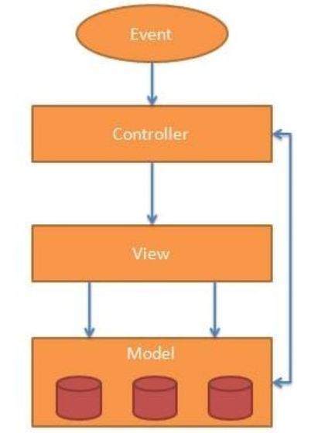
AngularJS MVC Architecture
MVC stands for Model View Controller.
It is a software design pattern for developing web applications.
It is very popular because it isolates the application logic from the user interface layer and supports separation of concerns.

Slide 5
Description
Model: It is responsible for managing application data. It responds to the requests from view and to the instructions from controller to update itself.
View: It is responsible for displaying all data or only a portion of data to the users. It also specifies the data in a particular format triggered by the controller's decision to present the data.
Controller: It is responsible to control the relation between models and views. It responds to user input and performs interactions on the data model objects. The controller receives input, validates it, and then performs business operations that modify the state of the data model.

Slide 6
Angularjs Directives
It improve the feature or functionality of html elements.
Directives are markers on a DOM element which attach a special behavior to it.
For example, static Html does not know how to create and display a date picker widget.
To teach Html this new syntax we need a directive.
AngularJS directives are extended Html attributes with the prefix ng-.

Slide 7
Continue
The AngularJS framework can be divided into three major parts;
ng-app : The ng-app directive initializes an AngularJS application.
ng-model : ng-model directive binds the value of HTML controls (input, select, textarea) to application data.
ng-bind : ng-bind directive binds the AngularJS application data to HTML tags.

Slide 8
ng-app
The ng-app directive initializes an AngularJS application.
Using this directive you can tell which part of html contains Angularjs app.
The ng-app directive also tells AngularJS that the <div> element is the "owner" of the AngularJS application.
Below we use ng-app with <div> tag.
<div ng-app="">
Enter text <input type="text" ng-model="name">
<p ng-bind="name"></p>
</div>
You can use data-ng-, instead of ng-, if you want to make your page HTML valid.

Slide 9
ng-model
The ng-model directive binds the value of Html controls (input, select, textarea) to application data.
The ng-model directive defines the model/variable to be used in AngularJS Application.
In the following example, we define a model named name.
<div data-ng-app="">
1st number <input type="number" ng-model="num1">
2nd number <input type="number" ng-model="num2"> <p><b>Sum:</b> {{num1 + num2}}</p>
</div>

Slide 10
ng-init
The ng-init directive initialize application data same like variable initialization in C language, In c language you initialize int a=10;.
The ng-init directive initializes an AngularJS Application data.
It is used to assign values to the variables.
<div ng-app="" ng-init="name='Porter'"> // initialize name="Porter" Name: <input type="text" ng-model="name"> <p>name: {{ name }}</p>

Slide 11
ng-bind
The AngularJS ng-bind directive replaces the content of an HTML element with the value of a given variable, or expression.
Data binding in AngularJS is the synchronization between the model and the view.
If you change the value of the given variable or expression, AngularJS changes the content of the specified HTML element as well as.
<div ng-app="">
Enter text <input type="text" ng-model="name">
<p ng-bind="name"></p>
</div>

Slide 12
ng-model directive
The ng-model directive binds the value of HTML controls (input, select, textarea) to application data.
The ng-model directive can also:
Provide type validation for application data (number, email, required).
Provide status for application data (invalid, dirty, touched, error).
Provide CSS classes for HTML elements.
Bind HTML elements to HTML forms.

Slide 13
Application Status
The ng-model directive can provide status for application data (valid, dirty, touched)
Valid: if true, the value meets all criteria
Dirty: if true, the value has been changed
Touched: if true, the field has been in focus

Slide 14
Validate User Input
The ng-model directive can provide type validation for application data (number, e-mail, required)

Slide 15
CSS Classes
The ng-model directive provides CSS classes for HTML elements, depending on their status.
The ng-model directive adds/removes the following classes, according to the status of the form field.
ng-empty
ng-not-empty
ng-touched
ng-untouched
ng-valid
ng-invalid
ng-dirty
ng-pristine
Notes:
The ng-dirty class tells you that the form has been modified by the user, whereas
the ng-pristineclass tells you that the form has not been modified by the user.

Slide 16
ng-repeat
The ng-repeat directive repeats an Html element.
ng-repeat directive repeats a specific element.
<div data-ng-app="" data-ng-init="num=[1, 2, 3]">
<p data-ng-repeat="x in num">
{{ x }}
</p>
</div>

Slide 17
AngularJS Expressions
AngularJS expressions can be written inside double braces: {{ expression }}.
AngularJS expressions can also be written inside a directive: ng-bind="expression".
AngularJS will resolve the expression, and return the result exactly where the expression is written.
AngularJS expressions are much like JavaScript expressions: They can contain literals, operators, and variables.
Example {{ 5 + 5 }} or {{ firstName + " " + lastName }}

Slide 18
AngularJS expression is like JavaScript code expression except for the following differences:
AngularJS expression cannot contain conditions, loops, exceptions or regular expressions e.g. if-else, ternary, for loop, while loop etc.
AngularJS expression cannot declare functions.
AngularJS expression cannot contain comma or void.
AngularJS expression cannot contain return keyword.

Slide 19
Examples
AngularJS expression contains literals of any data type.
AngularJS expression can contain arithmetic operators which will produce the result based on the type of operands, similar to JavaScript:
AngularJS expression can contain variables declared via ng-init directive. The ng-init directive is used to declare AngularJS application variables of any data type.

Slide 20
Continue
AngularJS Numbers
AngularJS Strings
AngularJS Objects
AngularJS Arrays

Slide 21
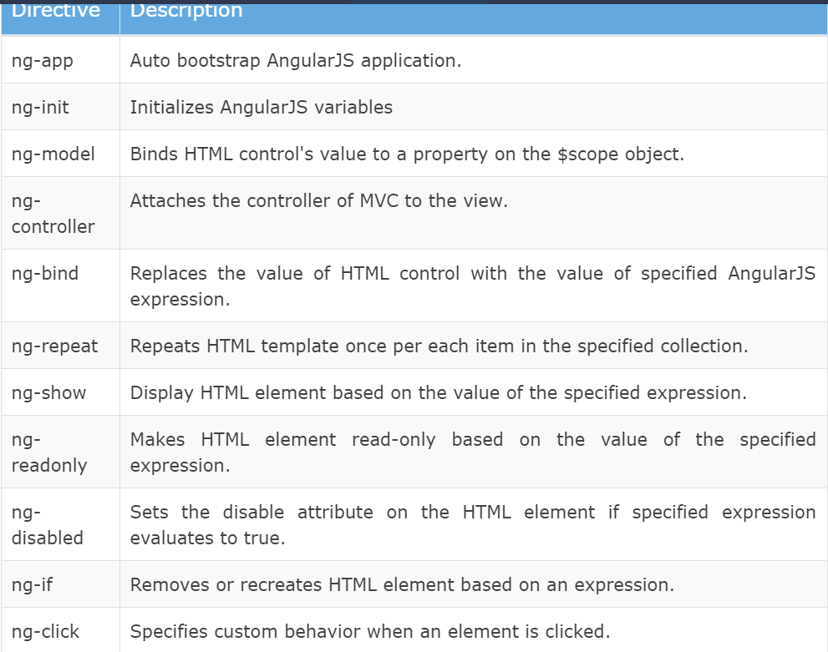

Slide 22
ng-if
The ng-if directive creates or removes an HTML element based on the Boolean value returned from the specified expression.
If an expression returns true then it recreates an element otherwise removes an element from the HTML document.

Slide 23
ng-readonly
The ng-readonly directive makes an HTML element read-only, based on the Boolean value returned from the specified expression.
If an expression returns true then the element will become read-only, otherwise not.

Slide 24
ng-disabled
The ng-disabled directive disables an HTML element, based on the Boolean value returned from the specified expression.
If an expression returns true the element will be disabled, otherwise not.

Slide 25
Directive Syntax
AngularJS directives can be applied to DOM elements in many ways.
It is not mandatory to use ng- syntax only.
Directive can start with x- or data-, for example ng-model directive can be written as data-ng-model or x-ng-model.
Also, the - in the directive can be replaced with : or _ or both.
For example, ng-model can be written as ng_model or ng:model.
It can also be a mix with data- or x-.

Slide 26
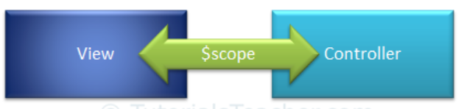
AngularJS Scope
The $scope in an AngularJS is a built-in object, which contains application data and methods.
You can create properties to a $scope object inside a controller function and assign a value or function to it.
The $scope is glue between a controller and view (HTML).
It transfers data from the controller to view and vice-versa.
The scope is the binding part between the HTML (view) and the JavaScript (controller).

Slide 27
Continue
The view can display $scope data using an expression, ng-model, or ng-bind directive.
AngularJS creates and injects a different $scope object to each controller in an application.
So, the data and methods attached to $scope inside one controller cannot be accessed in another controller.
With the nested controller, child controller will inherit the parent controller's scope object.
Therefore, child controller can access properties added in parent controller but parent controller cannot access properties added in child controller.

Slide 28
Note:
The ng-model directive is used for two-way data binding.
It transfers the data from controller to view and vice-versa.
An expression and ng-bind directive transfers data from controller to view but not vice-versa.

Slide 29
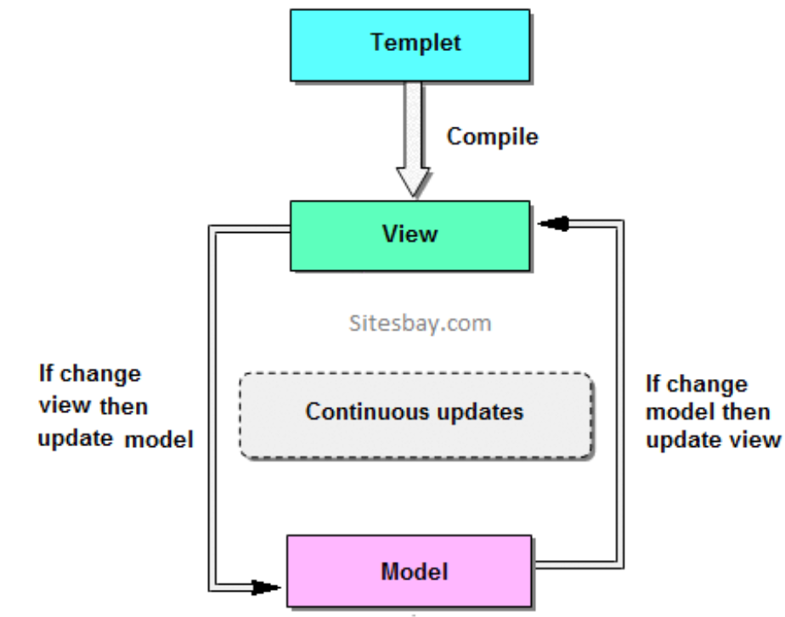
Two-Way Binding
The binding goes both ways.
If the user changes the value inside the input field, the AngularJS property will also change its value.

Slide 30
Understanding the Scope
If we consider an AngularJS application to consist of:
View, which is the HTML.
Model, which is the data available for the current view.
Controller, which is the JavaScript function that makes/changes/removes/controls the data.
Then the scope is the Model.
The scope is a JavaScript object with properties and methods, which are available for both the view and the controller.

Slide 31
$rootScope
An AngularJS application has a single $rootScope.
All the other $scope objects are child objects.
The properties and methods attached to $rootScope will be available to all the controllers.
The $scope object contains various methods.

Slide 32
Root Scope
All applications have a $rootScope which is the scope created on the HTML element that contains the ng-app directive.
The rootScope is available in the entire application.
If a variable has the same name in both the current scope and in the rootScope, the application uses the one in the current scope.
The following table lists important methods of $scope object.

Slide 33
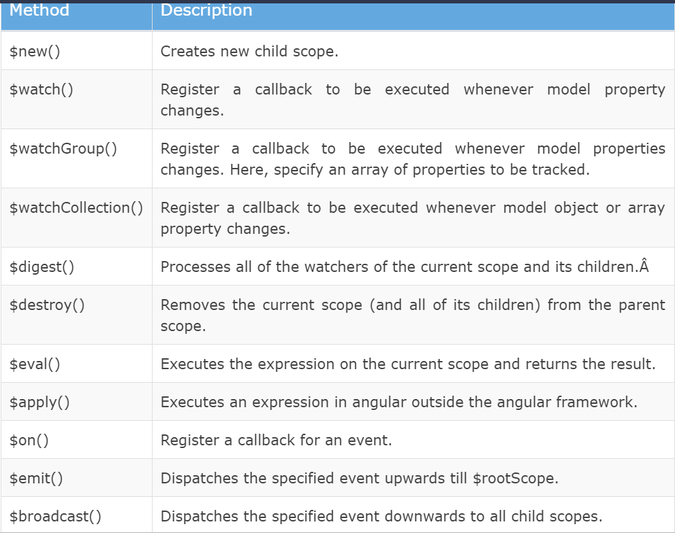

Slide 34
$watch
Angular scope object includes $watch event which will be raised whenever a model property is changed.
$watch registers a callback, which will get called whenever the specified model property "message" changes.

Slide 35
Angularjs Controller
AngularJS applications are controlled by Controller.
AngularJS controllers are used for control the data of AngularJS applications.
AngularJS controllers are regular JavaScript Objects.
For define controller in AngularJS application we need ng-controller directive names.
Notes:
In AngularJS, a Controller is defined by a JavaScript constructor function that is used to augment the AngularJS Scope.
Controllers can be attached to the DOM in different ways. For each of them, AngularJS will instantiate a new Controller object, using the specified Controller's constructor function:
the ngController directive. A new child scope will be created and made available as an injectable parameter to the Controller's constructor function as $scope.

Slide 36
AngularJS Controller
The controller in AngularJS is a JavaScript function that maintains the application data and behavior using $scope object.
You can attach properties and methods to the $scope object inside a controller function, which in turn will add/update the data and attach behaviours to HTML elements.
The ng-controller directive is used to specify a controller in HTML element, which will add behavior or maintain the data in that HTML element and its child elements.

Slide 37
Controller Example
Example demonstrates attaching properties to the $scope object inside a controller and then displaying property value in HTML.
Now, to create "myController", we need to create an application module.
After creating a module, we add a controller function using the controller() method where the first parameter should be the name of the controller and second parameter should be a function for the controller.
The controller function includes $scope parameter which will be injected by AngularJS framework.

Slide 38
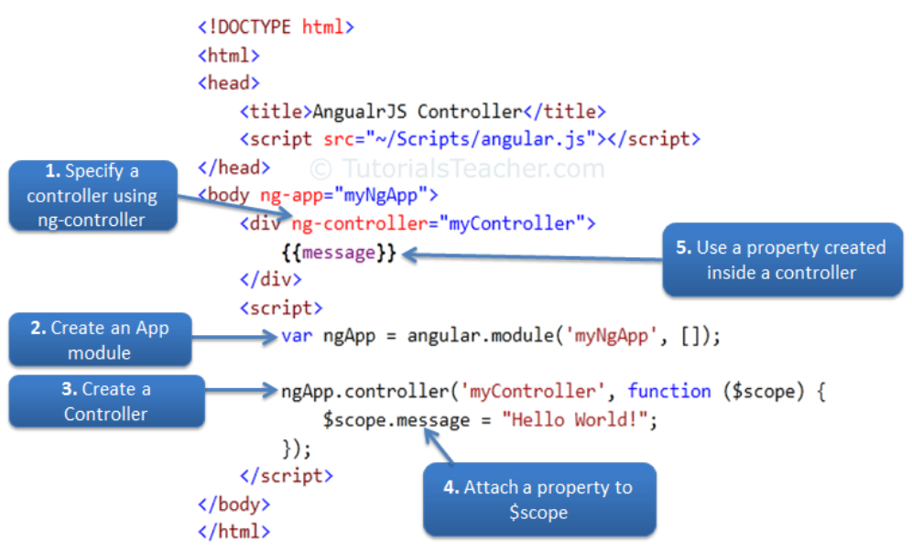
Example

Slide 39
Attach Behaviors
You can attach multiple methods to the scope object inside a controller, which can be used as an event handler or for other purposes.
Example:
Handle Button Click
Note that the properties and methods attached to the scope object inside a particular controller is only available to the HTML elements and its child elements where ng-controller directive is applied.

Slide 40
Attach Complex object
You can also attach an object to the $scope inside controller and display value of its properties in HTML.
Example: Attach an object
A student object is attached to the $scope and its properties and methods can be accessed using an expression, ng-model, or ng-bind directives with dot notation.

Slide 41
Nested Controllers
Angular allows nested controllers.
Example
a child controller can access properties and methods attached in parent controller function, whereas parent controller cannot access properties and methods attached in child controller.

Slide 42
Controller Methods
Controllers In External Files
In larger applications, it is common to store controllers in external files.
Just copy the code between the <script> tags into an external file named personController.js:

